Slide 1


CLOUD INFRASTRUCTURE FINAL PROJECT
CARLOS & MOHAN

Slide 2
WHY AWS?
It Has Been Around the Longest
Amazon introduced the world to Amazon Web Services in 2006
The biggest cloud provider
AWS has more than ten times the computing capacity of the next 14 largest infrastructure vendors combined.” AWS has multiple data centers located across the globe. As it stands, AWS has 33Availability Zones within 12 cloud regions.

Slide 3
Key Differences Between AWS and Azure
Azure is open to Hybrid cloud systems whereas AWS is less open to private or third-party cloud providers.
AWS follows pay as you go and they charge per hour whereas Azure also follows pay as you go model and they charge per minute which provides more exact pricing model than AWS.
AWS has more features and configurations and it offers a lot of flexibility, power, and customization with support for many third party tools integration. Whereas Azure will be easy to use if we are familiar with windows as it is a windows platform and it’s easy to integrate on-premises windows servers with cloud instances to create a hybrid environment.
Source: https://www.educba.com/aws-vs-azure

Slide 4
BASIC INFRASTRUCTURE
Preferred Cloud Platform - Amazon Web Service (AWS)
Terraform tool to automate the deployment of Virtual Machines.
Ansible is a radically simple IT automation engine that automates cloud provisioning, configuration management, application deployment, intra-service orchestration, and many other IT needs.
Github is a code hosting platform for version control and collaboration. It lets you and others work together on projects from anywhere.

Slide 5
BASIC INFRASTRUCTURE
Docker is an open platform for developing, shipping, and running applications. Docker enables you to separate your applications from your infrastructure so you can deliver software quickly with Docker, you can manage your infrastructure in the same ways you manage your applications.
Kubernetes is an open-source container orchestration platform that enables the operation of an elastic web server framework for cloud applications. Kubernetes can support data center outsourcing to public cloud service providers or can be used for web hosting at scale

Slide 6
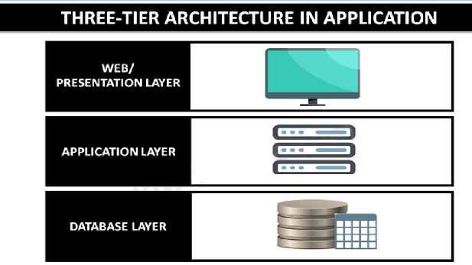
Scope of Work
A development infrastructure:
Webserver machine, ts job is to establish a connection between a server and the browsers of website visitors (Firefox, Google Chrome, Safari, etc.) while delivering files back and forth between them (client-server structure).
App Server machine, is designed to install, operate and host applications and associated services for end users, IT services and organizations and facilitates the hosting and delivery of high-end consumer or business applications
Database machine, a database and a program for managing read and write access to a database. This tier may also be referred to as the storage tier and can be hosted on-premises or in the cloud
A production kubernetes cluster composed of a master and two workers on which the containerised application is deployed

Slide 7
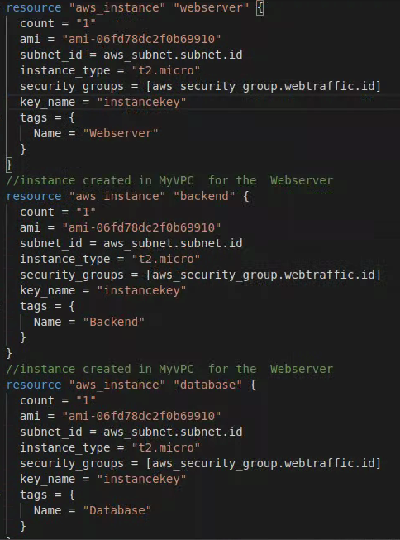
Terraform
Deployment of the three machines:

Slide 8
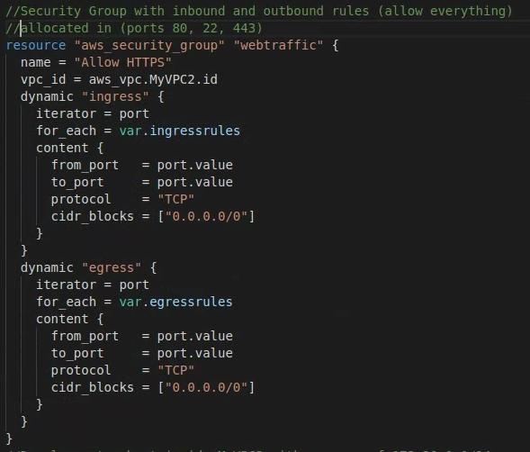
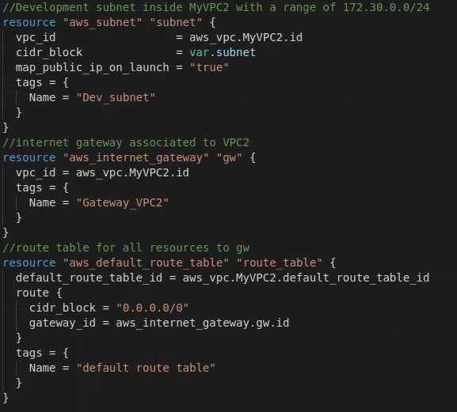
Terraform
Configuration of the Network for
the deployment of the instances

Slide 9
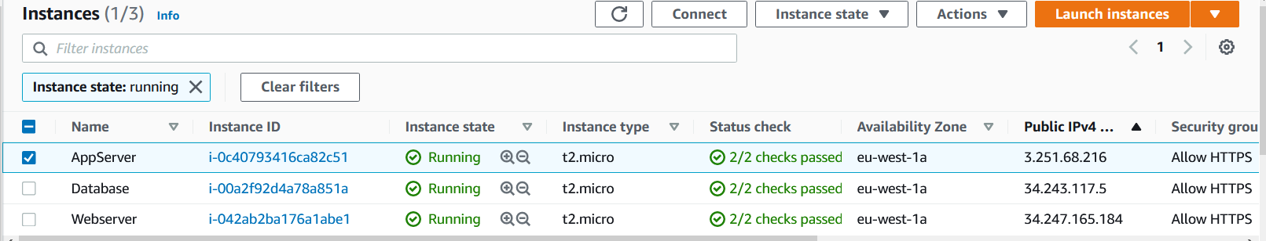
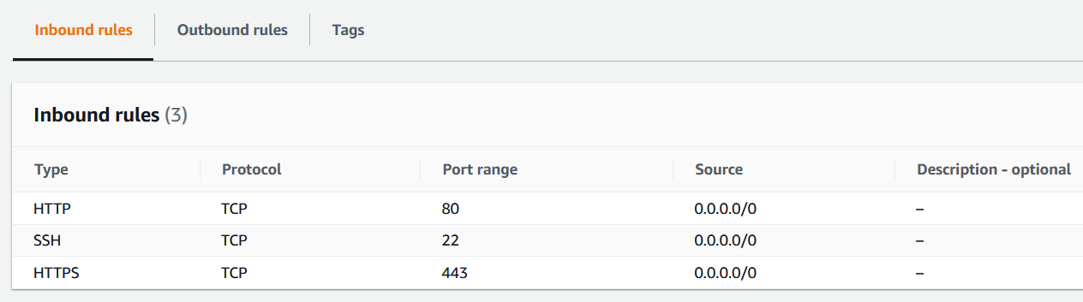
Terraform
Three servers deployed by Terraform

Slide 10
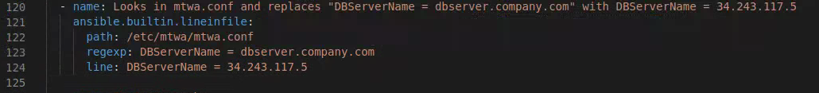

ANSIBLE
Two playbooks were used:
Webserver and Appserver;
Database Server;
Main tasks used:
Looks in specified path and replaces an expression/word with a desired one:
Downloads a git repository and stores it in a desired directory:

Slide 11
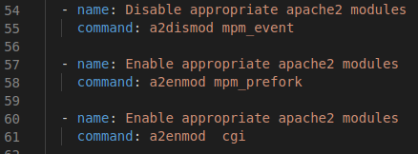

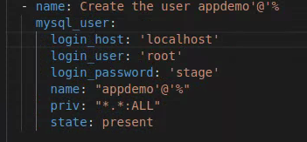
ANSIBLE
Enable/disable apache2 modules
Download a file from an url link into a specified directory
Creation of an user in MySQL database:

Slide 12
ANSIBLE
Enable/disable apache2 modules
Download a file from an url link into a specified directory
Creation of an user in MySQL database:

Slide 13
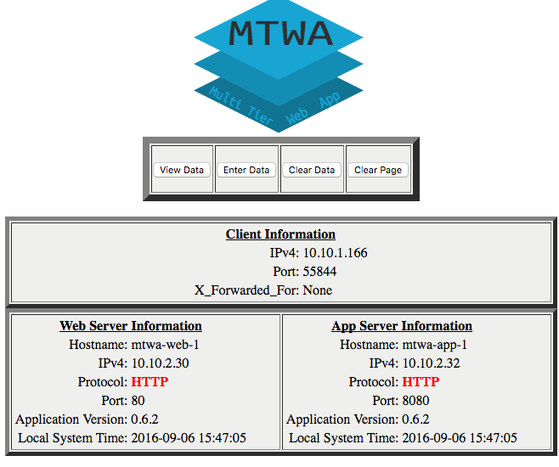
ANSIBLE PLAYBOOK
Three tier app user interface webpage:

Slide 14
Docker

Slide 15
Kubernetes

